Slide 1
An Introduction to A Song of Ice and Fire & Game of Thrones
By zhzh2001 aka. Zhang Zheng

Slide 2
A Song of Ice and Fire
An epic fantasy novel series by George R. R. Martin
Set on the fictional continents Westeros and Essos
Medieval-like world with various magic elements
Consists of seven volumes, five published
Character’s success or survival never certain
Use limited Point of View, inaccurate information
Real as historical novels, well-built characters, unpredictable plot

Slide 3
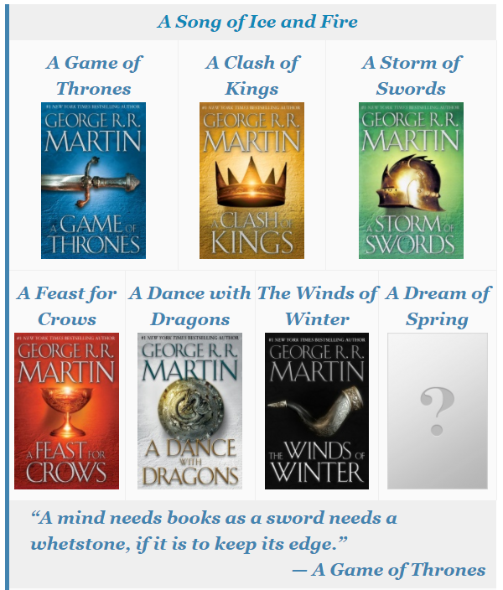
The Books
A Game of Thrones (1996)
A Clash of Kings (1998)
A Storm of Swords (2000)
A Feast for Crows (2005)
A Dance with Dragons (2011)
To be continued

Slide 4
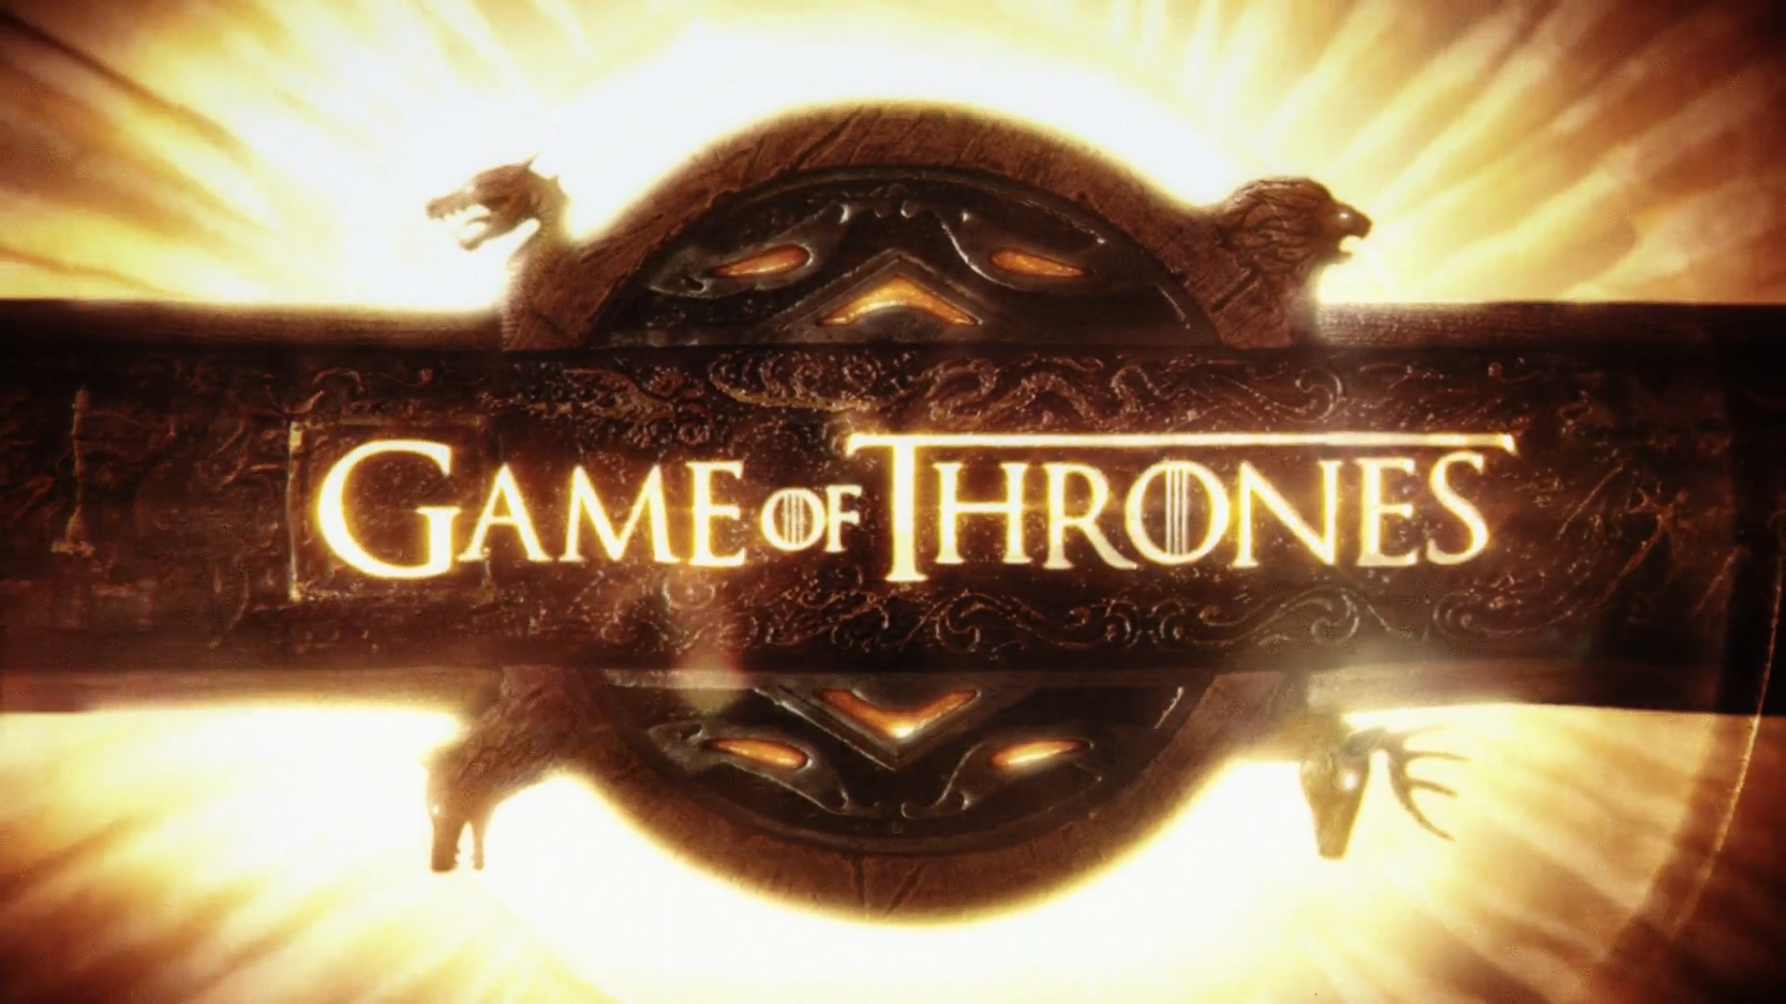
Game of Thrones – HBO TV series
By David Benioff & D. B. Weiss
Based on the novels
Eight seasons (2011-2019)
Later seasons considered controversial, especially the ending
Possibly excessive sex and violence

Slide 5
Magic and Religions
Dragons, Others, the Lord of Light, the old gods and the new
My favorite magical ability: warg / skinchanger of the First Men
In Norse mythology, warg ➔ Fenrir, a monstrous wolf
In Middle-earth, the Orcs usually ride on wargs, fierce large wolves
Skinchangers: enter the minds of animals, use their senses and control them; wargs: specialize in wolves
My preference for animals, animism and wolves particularly
The bond between human and animals, animals in equal position with human

Slide 6
Downsides of Magic
Unlike in Harry Potter, magic was unpredictable, unsystematic and costly
Dragons rebirth
King’s blood
Jojen paste
Except Bran, Arya and Jon (possibly Rickon) couldn’t warg at will
Children of the Forest, giants, mammoths, direwolves, even Others gradually extinct
Similar to The Lord of the Rings, the decline of elves and other races

Slide 7
Unpredictable plot & no distinct good/evil
Characters you love or hate could fail or die at any time
The Red Wedding
Robb Stark, King in the North
Catelyn Tully Stark, his Mother
The Starks scattered afterwards
Jon Snow, L. C. Night’s Watch
Eddard Stark’s death
Who to blame?
Eddard: Stannis true heir
Cersei: Protect her children
Renly: I’m king
Sansa: Love Joffrey
Littlefinger: Making chaos
Varys: For the Realm

Slide 8
Good Luck & Have Fun
The night is dark and full of horror

